Slide 1


Slide 2
Ecology
By
A.K Ramanujan

Slide 3
I Degree General English
Poetry- Ecology
Presented By
V.Lydia Vedam, M.A, M.Ed
Lecturer in English
JMJ College For Women, Tenali

Slide 4
The day after the first rain,
Monsoon.
for years, I would home
in a rage,
Interesting. What are you so mad about, speaker?
for I could see from a mile away
From a mile away, on the way home
our three Red Champak Trees
OUR three red champak trees
had done it again,
meaning they've done it before

Slide 5
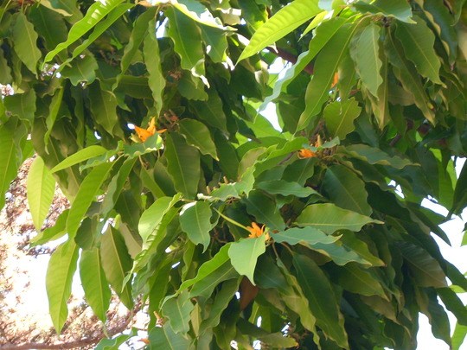
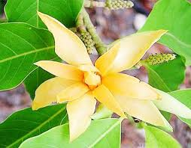

Slide 6
had burst into flower and given Mother
her first blinding migraine
first but not last; blinding because of the extent of the pain she's in in
of the season
these migraines last the whole season
with their street-long heavy-hung
yellow pollen fog of a fragrance
The pollen grains have made the air thick like fog - in fact the air is yellow with it's heady scent
no wind could sift,
the breeze cannot blow away this fog

Slide 7
no door could shut out
and the doors cannot keep it out either. the whole street in front of them is thick with it; it will seep in through the gaps
from our black-
pillared house whose walls had ears
and eyes,
begins personifying the house
scales, smells, bone-creaks, nightly
visiting voices, and were porous
pollen will get in through the holes
like us,
self-explanatory: we will breathe in this fog of pollen

Slide 8
but Mother, flashing her temper
like her mother's twisted silver,
giving the mother's anger some physical quality: shiny, radiant, expressive in her temper
grandchildren's knickers
soaked, then wrung (twisted)
wet as the cold pack on her head,
wet because she was sweating - cold sweats
would not let us cut down
a flowering tree
Flowering tree. Religious significance. Bad omen.
almost as old as her, seeded,
she said, by a passing bird's
providential droppings
Taken as a blessing - came from the sky

Slide 9
to give her gods and her daughters
and daughters' daughters basketsful
of annual flower
This^ is the extent of what this tree is good for.
and for one line of cousins
adower of migraines in season.
Burn!
(perhaps the pollen allergy is inherited?)

Slide 10
Summary
This poem, ‘Ecology’ is taken from Ramanujan’s third volume of poems, ‘Second Sight’, published in 1986. The speaker seems to be the poet himself or some imaginary person who is loyally devoted to his mother. He is very angry because his mother has a severe attack of migraine; a very bad kind of headache, often causing a person to vomit; which is caused by the fragrance of the pollen of the flower of the Red Champak every time it is in bloom. The fragrance is heavy and suffocating as the yellow pollen spreads everywhere. Even the doors of the speaker’s house cannot prevent the strong smell from entering the house. The walls of the house are able to absorb almost everything-the sounds, sights, the human voices, the harsh sounds produced when new shoes are worn. But they cannot stop the fog of pollen dust from the Champak trees.

Slide 11
The loving son therefore decides to cut down the tree, but he is prevented from doing so by his mother who sees the positive side of the tree in her garden. She says that the tree is as old as her and had been fertilized by the droppings of a passing bird by chance which is considered to be a very good omen. The positive side of it is that the tree provides many basketful of flowers to be offered to her gods and to ‘her daughters and daughter’s daughters’ every year, although the tree would give a terrible migraine to one line of cousins as a legacy. The yellow pollen fog is the yellow dust of pollen carried in the air which is thick and heavy like fog which covers the earth.

Slide 12
This poem portrays Ramanujan’s strong interest in the family as a very important theme of his poetic craft. His memories of the past would inevitably bring pictures of his family, especially his mother who is self sacrificing. There is also a reference to his Hindu heritage as he mentions the gods and the ancient beliefs in the poem. The sense of irony is indicated when the mother very angrily protests the idea of cutting down the tree even though she is suffering very badly from the migraine caused by it. She has a kind of emotional attachment to the tree, saying that it is as old as herself.

Slide 13
‘Ecology is a poem which could be read as one single sentence. However, each stanza has one particular idea. There is a casual connection between the ideas and they flow from one stanza to the next. ‘Flash her temper’; an instance of the use of irony because she is very angry at the idea of having the tree cut down. The actual meaning of the word ‘Ecology’ is not followed here but the poet seems to convey the thought that a particular kind of tree may have both negative and positive factors and therefore it need not be pulled down.

Slide 14


